Slide 1
Running a small business
Task A: Profit in percentages
1) Fill in the blanks for this small business’ first few years of results and comment on how their profit margin is changing.
 | Gross profit | Revenue | Gross profit margin
Year one | £0 | £12 000 | 0%
Year two | £1000 | £20 000 | 5%
Year three | £6000 | £48 000 | 12.5%
Year four | £20 000 | £50 000 | 40%
Year five | £24 500 | £56 000 | 43.75%
You might have reported, “Whilst revenue increases are slowing the gross profit margins have increased to a healthy level”.
2) Calculate the gross profit margin for each of these items for this new paddleboard shop.
a) 10 ft paddleboard: Selling price £575, cost price £373.75
35%
b) 12 ft paddleboard: Selling price £650, cost price £390
40%
c) Carbon paddle: Selling price £110, cost price £82.50
25%
d) Buoyancy aid: Selling price £60, cost price £34.50
42.5%
e) Comment on which product is not achieving their 30% gross profit margin target and advise on what they should do.
e) The carbon paddle is not achieving 30% G.P. The business needs to either find a cheaper supplier, raise the selling price, or stop selling this product.

Slide 2
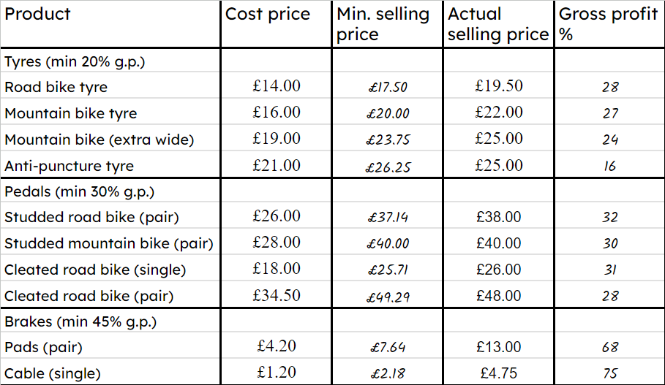
Running a small business
3) a) By completing a spreadsheet or otherwise, calculate the minimum selling price and gross profit margins for this bicycle shop’s products.
b) Comment on any products not achieving minimum gross profit margins.
Anti-puncture tyres and cleated pedals (pair) do not achieve minimum G.P. margins.
c) Advise the business as to which products they should place most prominently in their shop.
They should place brake cables most prominently in their shop.

Slide 3
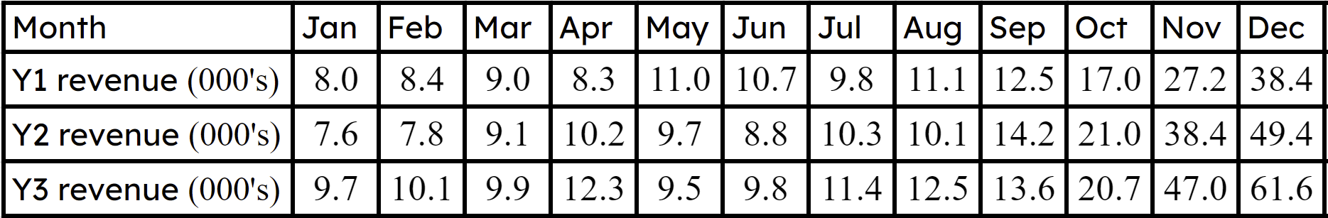
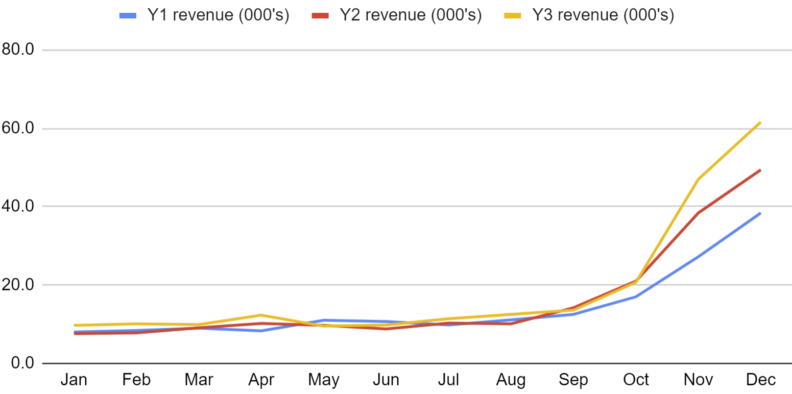
Running a small business
Task B: Tracking performance
1) Here are the first three years of sales for a new small business.
a) Calculate the mean and range for each year and comment on any changes year-on-year.
Year one:
Year two:
Year three:
Range: £30 400
Range: £41 800
Range: £52 100
Mean: £14 283
Mean: £16 383
Mean: £19 008
You might have said, “The mean is increasing so the business is selling more year-on-year. The range is increasing so the sales are becoming less consistent, less predictable month-on-month”.
b) Open the spreadsheet, highlight this range of data, and click insert/chart to graph the sales data year-on-year.
c) Comment on any patterns you spot in the data.
ou might have said, “The graph shows that there is a seasonal peak to the business’ sales in Nov/Dec. Their performance is level year-on-year Jan to Sept but the Oct/Nov/Dec sales are improving with each year”.
Mathematics in Education and Industry
v2.4

